Slide 1


1
A SURVEY OF AUTONOMOUS DRIVING: COMMON PRACTICES AND EMERGING TECHNOLOGIES
NAME:NAZIFA BUSHRA
ID: 20101536
COURSE: CSE438
SECTION: 1

Slide 2

2
INTRODUCTION
Automated Driving Systems (ADS) have emerged as a transformative paradigm in transportation, combining advanced technologies to redefine the future of mobility. The Importance of ADS in Modern Transportation cannot be overstated, as it holds the promise of significantly enhancing road safety and traffic efficiency.
Navigating Road Safety Challenges:
A staggering 94% of road accidents stem from human errors (NHTSA Report [1]).
ADS promises a paradigm shift, aiming to prevent accidents, reduce emissions, and redefine mobility.
Towards a Billion-Dollar Revolution:
Projected annual social benefits of nearly $800 billion by 2050 (NHTSA Report [3]).
ADS offers solutions for congestion, road casualties, energy consumption, and productivity.
Accelerating Progress:
Breakthroughs in vehicle dynamics, deep learning, and sensor modalities fuel ADS advancements.
The public's growing interest and market potential drive varying degrees of automation in ADS.
Crucial Challenges:
Despite progress, robust automated driving in urban environments remains an elusive goal.
Accidents caused by immature systems undermine trust and highlight the need for a thorough investigation.
This study explores the intricate aspects of ADS, delving into risk and uncertainty assessment, human driving behavior understanding, and driving style recognition. By addressing these key components, the research aims to contribute to the continual evolution of ADS, ensuring safer, more efficient roads for the future.

Slide 3



3
PROSPECTS AND CHALLENGES
A. Social Impact
Promising Horizons
Solving Problems: Preventing accidents, mitigating congestion, reducing emissions.
Unlocking Opportunities: Reallocation of driving time, enhanced mobility for the elderly.
Embracing Trends: Shift to Mobility as a Service (MaaS) and logistics revolution.
B. Challenges
Navigating Complex Terrain
SAE's Levels: Levels 0-2 involve basic automation; Level 3 demands quick human takeover.
Level 3 Challenges: Increased collision risks during manual takeover.
Levels 4 and 5 Hurdles: Infrastructure challenges; no production vehicle attains level 4 or 5.
Urban Road Networks: Challenges in achieving level 4 and above in unpredictable urban environments.
Safety and Perception: Accidents, fatalities, ethical dilemmas impact public trust.
Certification: Lack of established risk and reliability certification.
Optimization Complexities: Balancing goals adds complexity; open problem in dynamic driving tasks.

Slide 4

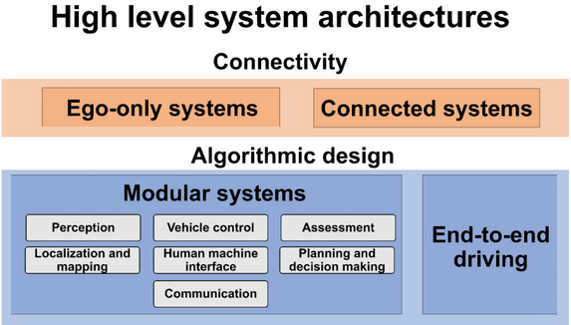
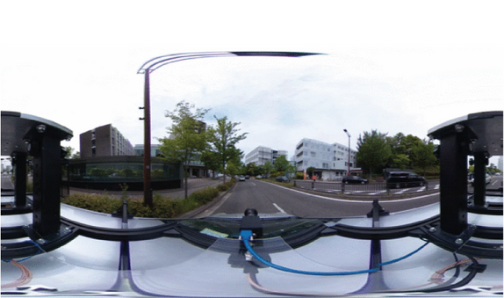
SYSTEM COMPONENTS AND ARCHITECTURE
4
Mission
A. System Architecture
Standalone, Ego-Only Systems: Single self-sufficient vehicle, practical for development.
Modular Systems: Pipeline structure, modules for core functions, advantages in problem-solving.
End-to-End Driving: Direct ego-motion generation, challenges in safety, interpretability.
Connected Systems: Emerging VANET technology, potential benefits in data sharing, challenges in security.
Vision
B. Sensors and Hardware
Monocular Cameras: Color sensing, affected by illumination.
Omnidirectional Camera: 360° 2D vision, desirable for navigation.
Event Cameras: Asynchronous data recording based on visual stimulus changes.
Radar: Active sensor, emits radio waves, effective for distance measurement.
Lidar: Emits infrared light waves, high accuracy under 200 meters.

Slide 5
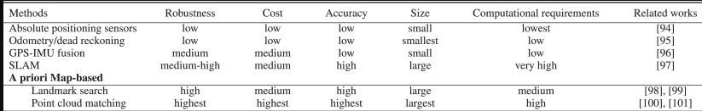

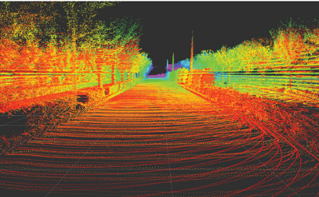
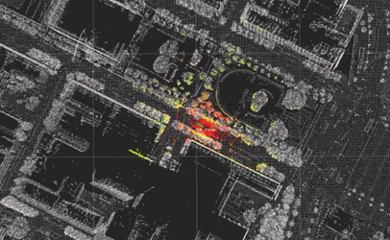
5
LOCALIZATION TECHNIQUES
Simultaneous Localization And Mapping (SLAM)
GPS-IMU Fusion
A Priori Map-Based Localization
Integrates GPS and IMU to correct dead reckoning errors. GPS provides absolute position readings, addressing IMU's accumulated errors. Challenges include accuracy drops in urban areas.
Performs online map creation and vehicle localization without a priori information. Versatile but computationally challenging for outdoor ADS applications.
Relies on matching online readings with a pre-built map. Two approaches include Landmark Search (using distinct features) and Point Cloud Matching (comparing online-scanned point clouds). Emerging 2D to 3D Matching explores monocular camera use for cost-effective alternatives to lidar.

Slide 6

6
Perception Overview
Object Detection
Road and Lane Detection
Future Trends
Challenges
Image-Based: YOLO and SSD for real-time, low-memory detection.
Semantic Segmentation: Mask R-CNN and DeepLabv3 for pixel-wise classification.
3D Object Detection: VoxelNet and SECOND use lidar for accurate 3D detection.
Radar and Lidar: Radar for long-range, lidar for precise localization, often used together.
Object Tracking: Kalman filters, particle filters, and deep learning for smooth trajectory estimation.
Drivable Surface: Color corrections and filtering for road area identification.
Feature Extraction: Color statistics, gradient info, and ML-based segmentation for lane markings.
Model Fitting: Geometric fitting with parametric/non-parametric models for road continuity.
Temporal Integration: Dynamic info and filtering for smooth road and lane segmentation.
Illumination changes affecting cameras.
Weather impacting lidar and radar.
Diverse road topologies for robust detection.
Standardized road maps and ML-based road/lane classification for automation.
Ongoing advancements in perception methods for accuracy and efficiency.

Slide 7

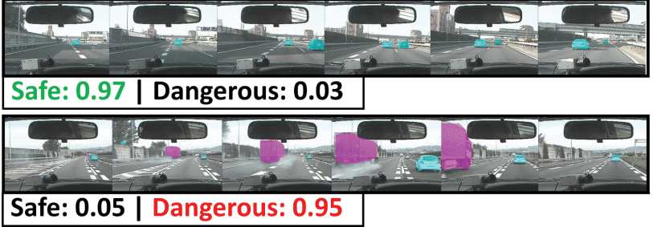
7
ASSESSMENT OF AUTONOMOUS DRIVING SYSTEMS
The ADS assessment involves three key aspects: Risk and Uncertainty Assessment, Surrounding Driving Behavior Assessment, and Driving Style Recognition. In risk assessment, Bayesian methods are used to quantify uncertainties in deep neural networks, enhancing overall system robustness. An alternative approach involves external risk inference frameworks, such as deep spatiotemporal networks. Surrounding driving behavior assessment focuses on understanding human driver intentions for better prediction and decision-making. Various methods, including Hidden Markov Models (HMMs) and Bayesian classifiers, aim to extend prediction horizons. However, challenges include short observation windows and real-time computation requirements. Driving style recognition, crucial for predicting individual behavior, has seen diverse approaches like rule-based models and machine learning techniques. While promising, successful integration into real-world ADS pipelines remains unreported, indicating a need for further exploration.

Slide 8

8
PLANNING AND DECISION MAKING
HUMAN-MACHINE INTERACTION IN AUTONOMOUS VEHICLES
The planning phase of ADS involves global route planning and local path planning. Global planning aims to find the optimal route from origin to destination on the road network. It utilizes well-established methods such as A search, separator-based techniques, hierarchical approaches, and bounded-hop techniques. Road hierarchy is exploited, and algorithms like Contraction Hierarchies (CH) are employed. Combining various algorithms, like Transit Node Routing with Arc Flags (TNR + AF), is common in state-of-the-art systems. In contrast, local planning focuses on executing the global plan, avoiding obstacles, and optimizing trajectories in the configuration space (C-space). Local planning methods include graph-based planners, sampling-based planners, interpolating curve planners, and optimization-based motion planners. Deep learning-based planners are emerging as alternatives, generating trajectories from sensory inputs. However, challenges like jerky trajectories and integration into real-world systems persist.
Human-Machine Interaction (HMI) in autonomous vehicles varies based on automation levels. For primary driving tasks, visual interfaces are preferred, but they can be distracting. Auditory User Interfaces (AUI) provide omni-directional cues and are less visually taxing. However, Automatic Speech Recognition (ASR) faces challenges in the vehicle environment. At automation levels three and four, mutual understanding between users and ADS is crucial. The transition between manual and automated driving poses challenges, and efficient handover interaction modules are yet to be developed. While experimental systems exist for driver monitoring and handover preparation, real-world systems with effective handover mechanisms remain an open problem requiring further research.

Slide 9
9
DATASETS
DATASETS AND BENCHMARKS
FRAMEWORKS
AND SIMULATORS
SIMULATORS
PASCAL VOC: Early dataset, diverse classes.
KITTI Vision Benchmark: Labeled driving scenes, widely used.
UC Berkeley DeepDrive: Recent, annotated image data.
Cityscapes: Detailed urban scenes for computer vision.
nuScenes Dataset: Recent urban driving dataset with lidar and image sensors.
Naturalistic Driving Datasets: Captures real-world driving scenarios and driver behavior.
Simulator Datasets (e.g., CARLA): Virtual environments for algorithm testing.
Autoware: Open-source stack for real-world ADS development.
Apollo: Comprehensive open-source framework covering perception, control, and planning.
Nvidia DriveWorks: Tools and libraries for ADS applications, Nvidia hardware-focused.
openpilot: Open-source ADS platform emphasizing adaptive cruise control and lane-keeping.
CARLA: Urban driving simulator for safe virtual experiments.
TORCS: Racing simulator adaptable for driving algorithm testing.
Gazebo: Common simulation environment for robotics.
SUMO: Open-source platform for traffic simulations.
Integration of Real-World Measurements: Enhances simulation fidelity, bridging virtual and real-world testing.

Slide 10

10
CONCLUSION
In the fast-evolving landscape of automated driving systems, this survey highlights the captivating promise and current gaps in research. From diverse architecture models to sensing modalities, it unravels the complexities of algorithm precision and efficiency. Yet, challenges persist, from handling adverse road conditions and unpredictable weather to nascent vehicle-to-vehicle communication. The dream of cloud-based information management awaits infrastructure solutions, while the uncharted territory of human-machine interaction beckons exploration. However, amidst these challenges lie promising advancements discussed in recent research, showcasing the potential impact on automated driving technology. A clarion call for collaborative efforts across disciplines and robust public support sets the stage for a future where safe and efficient roads become a tangible reality.

